Slide 1

Optimizing Blended Learning for Higher Education Students in Malaysia: Exploring the Optimal Blend for Engagement and Learning Outcomes
Presenter: Ying Ming (S2180377)
Notes:
NOTE:
To change the image on this slide, select the picture and delete it. Then click the Pictures icon in the placeholder to insert your own image.

Slide 2
Table of Contents
Research Background
Problem Statement
Research Questions
Research Objectives
Scope and Contribution
Research Methodology
Appendix

Slide 3

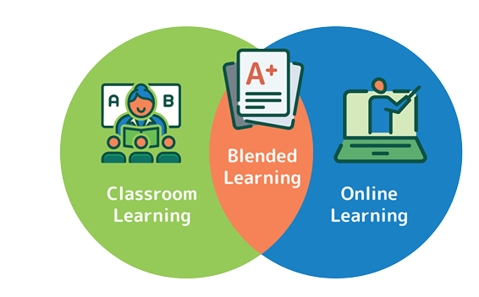
Research Background
What is Blended Learning?
An approach to education that combines online educational materials and opportunities for interaction online with physical place-based classroom methods.
The COVID-19 pandemic has accelerated the adoption of blended learning as institutions search for flexible and interactive learning environments. [Bordoloi, and Das (2021)]
Ministry of Higher Education of Malaysia, Datuk Seri Mohamed Khaled Nordin introduced hybrid, flexible learning system which mandatory university attendance only in first and final years. (04 June 2023)
Benefit for Blended Learning:
increased flexibility
personalized learning experiences
improved access to resources
Ministry of Higher Education, Datuk Seri Mohamed Khaled Nordin

Slide 4
Blended Learning’s impact on student engagement and learning outcomes
Several studies have examined the perceptions and experiences of students and educators towards blended learning.
Bordoloi, and Das (2021) revealing that students in India generally held positive perceptions towards online and blended learning during the COVID-19 pandemic.
Kang and Kim (2021) found that blended learning approaches positively influenced learning outcomes, including knowledge acquisition and problem-solving skills.
Xu, Yuan, and Liu (2021) explored student performance prediction based on blended learning, indicating that well-designed blended learning models can significantly contribute to students' academic success.
Musabirov & et al.(2019), Chango, Cerezo, and Romero (2019) and Van Goidsenhoven et al. (2020) are focused to examine the predictors of academic achievement in blended learning using multi-source data and learning analytics. These studies underscore the importance of leveraging data-driven insights to enhance the design and implementation of blended learning models.

Slide 5
Problem Statement
Issue 1
Limited understanding of the main factors influencing the ideal mix of online and in-person teaching in blended learning for students in Malaysia.
Bordoloi, and Das (2021) – India
Banyen et al. (2016) – Thailand
Kang and Kim (2021) – Public Healthcare course in South Korea
Bordoloi et al., 2021; Müller & Mildenberger, 2021 – Western Context
Impact of different ratios of online and face-to-face instruction on student engagement and learning outcomes in blended learning remains underexplored.
Xu, Yuan, and Liu (2021) – Well Designed Model is important but did not mention about the impact of ratios for online and face to face instruction
Park et al. (2016) – Lack of consensus on how to define and measure the optimal for blended learning
Van Goidsenhoven et al. (2020)- This study come out with factors influence student’s performance with blended learning but did not explore how these factors interact with each other or how they change over time.
Issue 2

Slide 6
Research Question and Research Objectives
Research Question
Research Objectives
What are the main factors influencing the optimal blend of online and face-to-face instruction in blended learning environments in Malaysia higher educations?
How do different ratios of online and face-to-face instruction affect student engagement and learning outcomes in blended learning for Malaysia higher educations?
What are the evidence-based recommendations can be provided on designing and implementing effective blended learning models?
Identify the main factors influencing the optimal blend of online and face-to-face instruction in blended learning environments.
To investigate the effects of different ratios of online and face-to-face instruction on student engagement and learning outcomes in blended learning.
To provide evidence-based recommendations on designing and implementing effective blended learning models.

Slide 7
Scope and Contribution
Scope:
Focus on exploring the optimal blend of online and face-to-face instruction in blended learning environments.
Targeting higher education students in Malaysia.
Contribution:
Addresses the knowledge gap in blended learning.
Conducts a comprehensive mixed-methods study.
Enhances instructional practices and informs effective blended learning models.
Optimizes the blend to create engaging and impactful learning experiences.
Improves educational outcomes and student success in higher education.

Slide 8
Research methodology

Slide 9
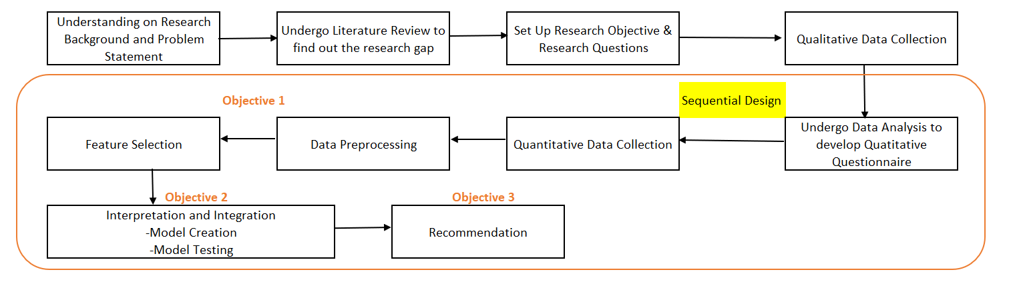
Research Design

Slide 10
Qualitative Phase
Discussions will be conducted with educators, instructional designers, and administrators who have experience with blended learning.
These qualitative data collection methods will provide insights into the factors influencing the optimal blend, such as learner characteristics, instructional goals, and learning strategies

Slide 11
Quantitative Phase
A survey questionnaire will be developed after data collection from qualitative phase.
It will administered to a larger sample of students, encompassing them from different faculties and courses.
The survey will gather data on student engagement levels, learning outcomes, and the perceived effectiveness of different ratios of online and face-to-face instruction.

Slide 12
Conclusion
This research study aimed to investigate the optimal blend of online and face-to-face instruction in blended learning environments for higher education students in Malaysia
The quantitative analysis revealed significant relationships between instructional ratios, student engagement levels, and learning outcomes.
The scope of this study focused specifically on the context of higher education students in Malaysia, providing valuable insights tailored to their needs.

Slide 13
Appendix
Bordoloi, R., Das, P., & Das, K. (2021). Perception towards online/blended learning at the time of Covid-19 pandemic: an academic analytics in the Indian context. Asian Association of Open Universities Journal, ahead-of-print(ahead-of-print).
Heilporn, G., Lakhal, S., & Bélisle, M. (2021). An examination of teachers’ strategies to foster student engagement in blended learning in higher education. International Journal of Educational Technology in Higher Education, 18(1). https://doi.org/10.1186/s41239-021-00260-3
Kang, H. Y., & Kim, H. R. (2021). Impact of blended learning on learning outcomes in the public healthcare education course: a review of flipped classroom with team-based learning. BMC Medical Education, 21(1). https://doi.org/10.1186/s12909-021-02508-y
Müller, C., & Mildenberger, T. (2021). Facilitating Flexible Learning by Replacing Classroom Time With an Online Learning Environment: A Systematic Review of Blended Learning in Higher Education. Educational Research Review, 34, 100394.
Singh, J., Steele, K., & Singh, L. (2021). Combining the best of online and face-to-face learning: Hybrid and blended learning approach for COVID-19, post vaccine, & post-pandemic world. Journal of Educational Technology Systems, 50(2).

Slide 14
Xu, Z., Yuan, H., & Liu, Q. (2021). Student Performance Prediction Based on Blended Learning. IEEE Transactions on Education, 64(1), 66–73.
Salas-Rueda, R. A. (2020). Impact of the WampServer application in Blended learning considering data science, machine learning, and neural networks. E-Learning and Digital Media, 17(3), 199-217.
Musabirov, I., Pozdniakov, S., & Tenisheva, K. (2019). Predictors of academic achievement in blended learning: The case of data science minor. International Journal of Emerging Technologies in Learning (Online), 14(5), 64.
Chango, W., Cerezo, R., & Romero, C. (2019, December). Predicting academic performance of university students from multi-sources data in blended learning. In Proceedings of the second international conference on data science, E-learning and information systems (pp. 1-5).
Van Goidsenhoven, S., Bogdanova, D., Deeva, G., Broucke, S. V., De Weerdt, J., & Snoeck, M. (2020, March). Predicting student success in a blended learning environment. In Proceedings of the tenth international conference on learning analytics & knowledge (pp. 17-25).

Slide 15
Wang, L., Huang, Y., & Omar, M. (2021). Analysis of blended learning model application using text mining method. International Journal of Emerging Technologies in Learning (iJET), 16(1), 172-187.
Park, Y., Yu, J. H., & Jo, I. H. (2016). Clustering blended learning courses by online behavior data: A case study in a Korean higher education institute. The Internet and Higher Education, 29, 1-11.
Banyen, W., Viriyavejakul, C., & Ratanaolarn, T. (2016). A Blended Learning Model for Learning Achievement Enhancement of Thai Undergraduate Students. International Journal of Emerging Technologies in Learning, 11(4).
Yapici, I. U., & Akbayin, H. (2012). The Effect of Blended Learning Model on High School Students' Biology Achievement and on Their Attitudes towards the Internet. Turkish Online Journal of Educational Technology-TOJET, 11(2), 228-237.
Salas-Rueda, R. A. (2018). Analysis on the use of continuous improvement, technology and flipped classroom in the teaching-learning process by means of data science. Online Journal of Communication and Media Technologies, 8(4), 325-343.
Salas-Rueda, R. A. (2020). Flipped classroom: Pedagogical model necessary to improve the participation of the students during the learning process. LUMAT: International Journal on Math, Science and Technology Education, 8(1), 271-296.

Slide 16
THANK YOU

